Slide 1
Community Clinics Teledermoscopy Service
South East Dermatology Transformation and Sustainability
Improving Care with Technology
Anna Bernard, Business Development Manager, Communitas Clinics
Notes:
Thank you for inviting us to present to you today – we would like to start with a big thank you for recognising our service in the shortlisting for this award
My name is Anna Bernard, I am the Business Development Manager for Communitas Clinic and I will presenting to you today
Dr Nilu Vajpeyi is the Clinical Director at Communitas Clinics - attended today to answer any clinical or commissioning questions that you have today

Slide 2
Background
A large proportion of the GP workload is for patients presenting with anxiety about skin lesions
Local engagement with Consultants suggested a large increase in referral for diagnostic uncertainty
Patients wanted access to care that was closer to home, especially those living in rural areas
Surrey downs is an outlier for Malignant Melanoma, our service acts as a safety net for suspicious lesions, facilitating the crucial fast tracking of patients to the cancer 2-week waiting list (current wait times are anywhere up to 5 months under routine referral).
Notes:
Thorough engagement with patients, GP and trust consultants indicated………….
A large proportion of the GP workload is for patients presenting with anxiety about skin lesions
Local engagement with Consultants suggested a large increase in referral for diagnostic uncertainty
Patients wanted access to care that was closer to home, especially those living in rural areas
Malignant melanomas are is significantly higher than the national with 21.0 per 100,000 compared to the national rate of 13.6
Our service was designed to respond to these indictaions and improve the overall Dermatology offering within the borough.
It acts as a as a safety net for suspicious lesions, facilitating the crucial fast tracking of patients to the cancer 2-week waiting list. (current wait times are anywhere up to 5 months under routine referral)

Slide 3
Challenges
Resistance from GPs regarding technology
Resistance regarding time required and perceived additional work load
New provider from out of borough
Trust from secondary care clinicians
Concerns from secondary care regarding demand reduction

Slide 4
Truly streamlined, interactive software
Bespoke tailored software
The Latest Dermatoscopic technology
Watch Our Demonstration Video Here
Notes:
We have designed bespoke software tailored to the needs of this service specification and local GPs. We believe that our cutting edge, interactive referral technology speaks for itself – this short video demonstrates how easy the system is to use whilst capturing high quality information to ensure that highest referral value without any impact to GP or patient resource.

Slide 5
GP engagement & education
Regular engagement and support:
Informed Software design
Support helpline pathway improvements
In house GP referral management processes
Timely support and specialist advice to improve Dermatology confidence within GP colleagues
Individualised, specific education provided for each and every referral
An education network provided by specialists to local clinicians, that count towards GP reaccreditation points
GP satisfaction
90% of GPs would strongly recommended this service to a colleague or friend
90% of GPs told us that their dermatology knowledge has enhanced from using this service
Notes:
Our GP colleagues have been engagement throughout design, implementation and on-going delivery of this service. Feedback has been considered and acted upon to implement improvements to service design, referral pathways and equipment to ensure maximum utilisation and benefit to primary care education and condition management, examples include improvements to referral template and management plan wording, inclusion of specific imaging feedback. Single point of access for support calls and best practice referral management guidelines for administration within practices.
Referring GPs are provided with a full teledermoscopy report and management plan for every referral to support primary care management, with images, feedback and diagnosis advice side by side to provide the opportunity for reflective learning for each case
This innovative education network provides GPs with consistent development opportunities which counts towards GP reaccreditation points
GP satisfaction is consistently high with 90% of GP colleagues advising us that they would strongly recommend our service to colleagues or friends and that their dermatology knowledge has enhanced at a result of using our service

Slide 6
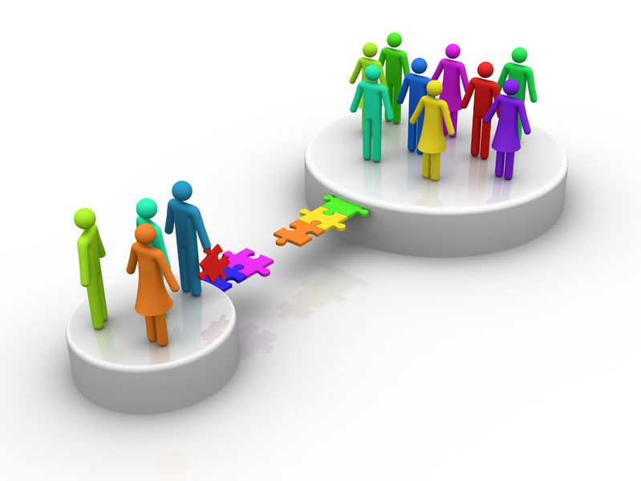
True collaboration
CCG and Provider relationship put care quality at the top of agenda throughout
Inclusion of Children in the pathway
Introduction of primary care low risk BCC clinics
On going collaborative vision for Dermatology within Surrey Downs
Pilot for Rashes
Notes:
Using accurate data compiled throughout service delivery and listening to valuable feedback from GP colleagues and trust consultants, we have worked together throughout service delivery to identify potential improvements to the Dermatology pathway. With Communitas and CCGs relationship putting quality of care at the top of our agenda.
The service has already been developed to include paediatrics
In response to a lack of local community provision the CCG have recently commissioned primary care low risk BCC clinics these clinics further improve patient access to services and reduce waiting times to 4 weeks
Our ongoing collaborative vision for Dermatology within Surrey Downs is to continue with an approach that segments the overall workload and utilises crucial skills in GPwSIs, specialist nurses and consultants to offer opportunities to improve the flow of patients and to create new and more effective models
We are currently developing a pilot for dermatological rashes that will provide similar rapid access to specialist advice supported by macro images upon referrals. This pilot will include network based educational clinics where patients can be treated jointly by their GP and supervising specialist Dermatologists – it is anticipated that this will reduce secondary care referrals by a further 40% and provide GP colleagues with practical development to fundamentally improve Dermatology care across the borough
We believe that the teledermoscopy service is a clear winner for the ‘Improving care with technology’ award not only because if it’s measurable quality outcomes delivered to date but also because of it’s scalability and future quality improvements it will deliver

Slide 7
High Quality Patient Care
Results in Measurable outcomes
Access to specialist Dermatology advice within 1 working day
Individualised self management
Improved Skin Cancer Outcomes 10% of referrals escalated to an urgent suspected cancer pathway reducing referral to treatment (RTT) times by 88 days
Over 65% of patients have been successfully managed in Primary care without the need for onward referral
This represents an NHS saving of 69% for each patient
CCG have reported a £388,000.00 reduction in Surrey Downs Dermatology spend compared to last year, with an out-turn in 2018/19 predicted to exceed this figure
Winner of HSJ improving care with technology award 2017
Notes:
Current waiting times of 3-4 months for first outpatient appointment, this service provides patients with access to specialist Dermatology advice within 1 working day
Individualised self management advice forms part of all teledermoscopy management plans including links to sun safety and mole check videos and patient information leaflets
10% of referrals that would otherwise have been routinely referred to hospital are escalated to an urgent cancer pathway - reducing skin cancer RTT times by 88 days
Over 65% of patients……

Slide 8
Measurable outcomes –
Satisfaction
Patient Satisfaction consistently 98% positive
Speedy service - Excellent :-)
So quick and informative - so much better than visiting theMy knowledge has been significantly enhanced hospital So quick and informative - so much better than visiting the hospital
Put my mind at rest – Fantastic – all in one appointment
GP Satisfaction consistently - 98% positive
- 99% said ‘The service supports me in diagnosing and managing my patients’
97% said ‘Management of my patients is improved’
78% said ‘My knowledge has been significantly enhanced’
Really helpful, efficient service
Has really helped my dermatology knowledge – the reflective learning is invaluable

Slide 9
Thank you

